Slide 1

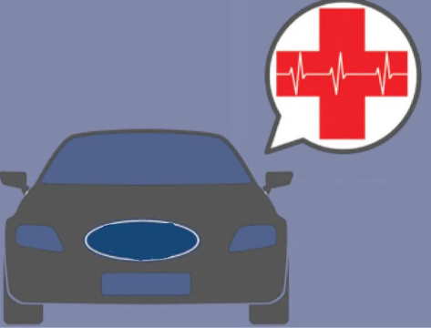
Front cover
Medical sensor in the car
sensor in car
Done by : Rahaf Sahir Salman
Group 6
October [2022]

Slide 2
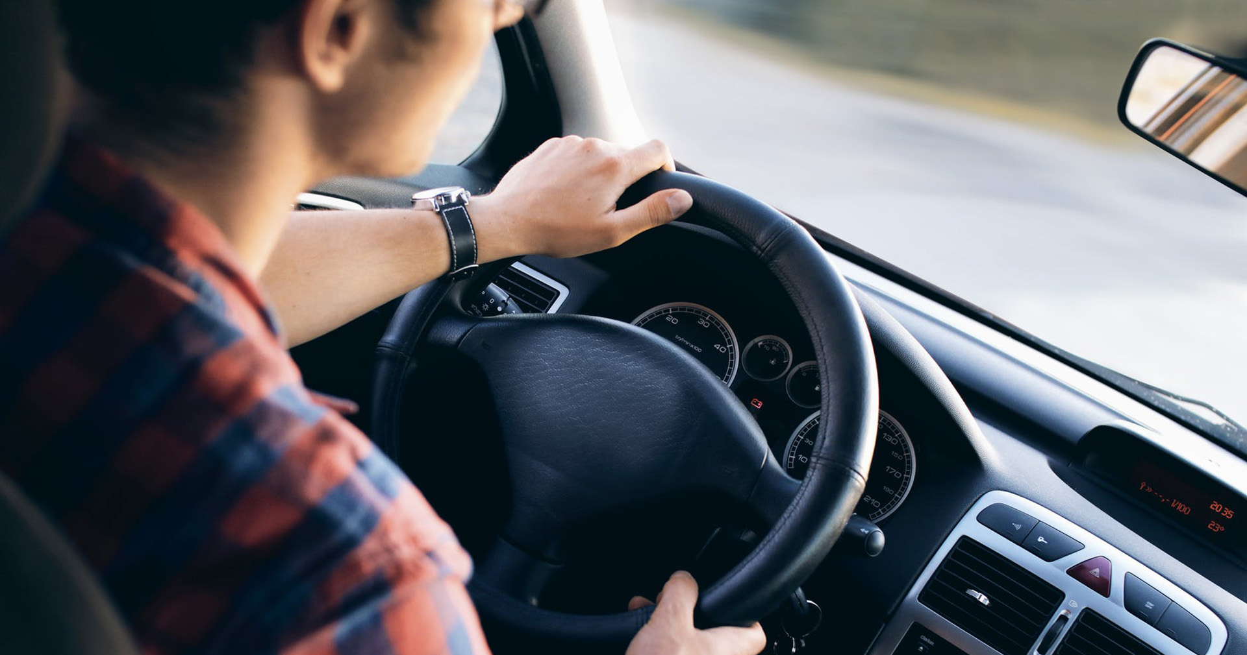
Introduction
Nowadays, people spend most of their time in the car, as it is the most common tool for transportation, With the same rate of car prevalence, the percentage of people with chronic diseases has increased, There was a need to link medicine and the car, so the most appropriate option was the sensor
References:
https://ackodrive.com/car-guide/different-types-of-car-sensors/

Slide 3

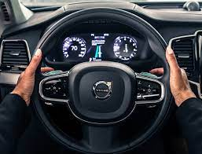
The idea :
The idea is to help people with chronic diseases monitor their heart rate and blood pressure through a sensor distributed around the steering wheel and connected to an alarm inside.
This sensor connects to the fingers of the hand around the steering wheel and measures and gives readings on demand, but when blood pressure or heart rate rises, it gives a warning to the driver that the measurements have exceeded the normal limit Where this information is displayed on the top of the car's center display.
.
3\11\2022
3
The idea is to help people with chronic diseases monitor their heart rate and blood pressure through a sensor that is distributed around the steering wheel and connected to an alarm device inside.

Slide 4
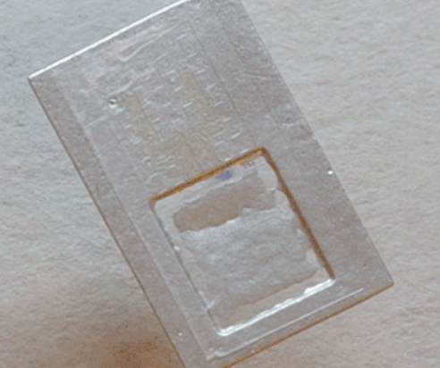
Medical sensor to measure your vital signs
These are the sensor discs that will be implanted around the steering wheel

Slide 5
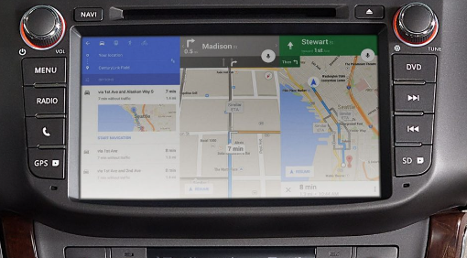
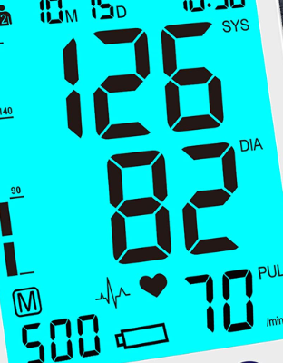
View readings
3\11\2022

Slide 6
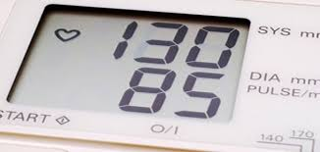
The importance of this idea
1
Reducing some of the accidents that occur due to these diseases
Ease of knowing blood pressure and heart rate and dispensing with a pressure device
2
Act faster when exposed to a state of high blood pressure, thus preserving the life of the person who drives and maintaining those who drive other cars around him
3

Slide 7

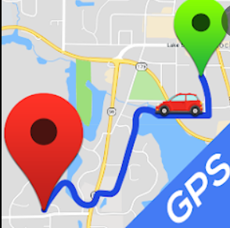
future development
It is also possible to work on developing this sensor so that when the blood pressure rises to a dangerous level, it gives a warning to the driver to stop and then sends a message to the nearest hospital so that this alarm is connected to the hospital and the hospital is automatically connected to the location service (GPS), so a message is sent to the nearest hospital Where this driver stopped and went to him in the shortest time and helped him

Slide 8
The sensors in the car are among the most important parts of the car on which the functioning of the car system as a whole depends. As there are many of these sensors in all cars such as the oxygen sensor, fuel temperature sensor and Proximity sensor
And many sensors whose primary goal is to maintain the safety of the person inside the car or the driver himself

